Slide 1
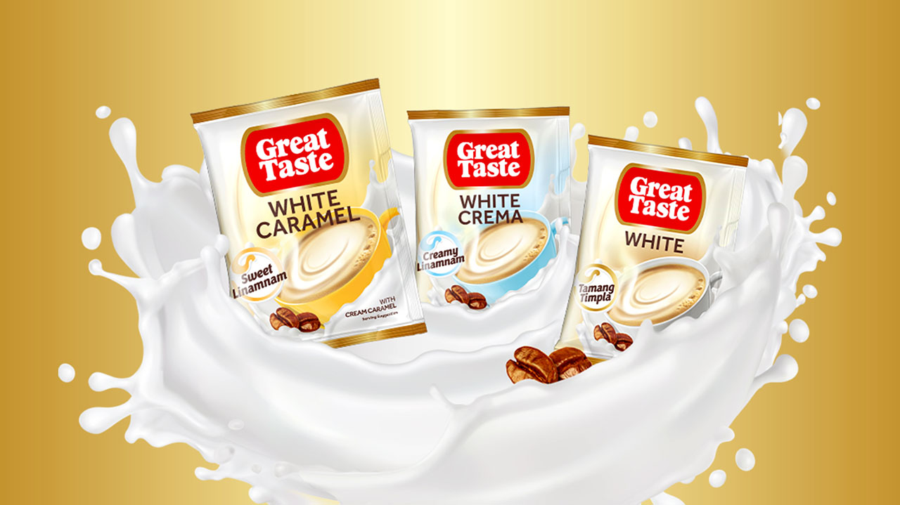



URC – Great Taste White
Facebook Deep-Dive Analysis – Data Review Deck
August 2021

Slide 2






Project Scope
Target Brand
Dependent Variables
Great Taste White Coffee (has 3 variants – Classic, Crema and Caramel)
Incremental sales derived from Facebook Execution
Independent Variables
Time Period
Campaigns (impressions) grouped by RAG for all metrics – Creative best practice, Frequency, Duration, Buying objective and Placement
FY 2018 – 53 WE 31/12/2018
FY 2019 – 52 WE 30/12/2019
FY 2020 – 53 WE 04/01/2021
YTD 2021 – 17 WE 30/04/2021
Total Analysis: 158 Weeks [01/01/2018 – 04/01/2021]
Market/Channel Breakdown
National – to be reported
Regions - available
Granularity
Reporting Results
National Level - Weekly
Incremental Volumes, Effectiveness, ROI

Slide 3
Facebook Best Practice Scorecard: CPG
Campaigns are split and graded by Facebook into Optimal, Opportunity to Improve and Sub-optimal (grading is subject to change)
Creative & Media Best Practices |  | Sub Optimal (0 points) | Opportunity to Improve (1 point) | Optimal (2 points)
Creative Best Practice | % Campaign impressions using optimized creative: Brand Link Highlight What Matters Sound Off Framed for Feed | <70% | 70% to 90% | > 90%
Frequency | Average Weekly Frequency | <1 per week | N/A | 1-3 per week
Duration | Campaign Duration | <2 weeks | 2 to 4 weeks | > 4 weeks
Buying Objective | Using Optimal Buying Objective | Clicks, Engagement, Likes | All Other | Reach, BAO, VV, Conversions, CatLog Sales, Store Traffic
Placements | Utilizing Multiple Placements | Less than 4 Placements | NA | 4+ more placements / Automatic Placements
Gamma | Based on Weighted Gamma scores | Bottom tier Campaigns based on weighted Gamma scores | Middle tier Campaigns based on weighted Gamma scores | Top tier Campaigns based on weighted Gamma scores
Total | Score out of 10 | <=3 | 4 to 7 | >=8

Slide 4
Business Questions
Overview of questions answered as part of deep dive analysis
Scope | Questions | Source
Impact of Best Practice Adoption on Performance | How has best practice adoption changed over time? What is the impact of best practice adoption on effectiveness and efficiency? What is the revenue opportunity available from driving best practice adoption? | Deep Dive Analysis
Campaign Element Deep Dives | Creative: What is the impact of implementing creative best practices on effectiveness? | Deep Dive Analysis (Data Permitting)
 | Reach: What is the impact of campaign reach on effectiveness and efficiency?
 | Frequency: What is the impact of campaign frequency on effectiveness and efficiency?
 | Duration: What is the impact of campaign duration on effectiveness and efficiency?
 | Optimisation Goal: What is the impact of different optimisation goals on effectiveness and efficiency?
 | Other Project Specific Hypothesis

Slide 5
Execution Summary
 |  | Impressions (in Millions)
Creative & Media Best Practices |  | Sub Optimal (0 points) | Opportunity to Improve (1 point) | Optimal (2 points)
Creative Best Practice | % Campaign impressions using optimized creative: Brand Link Highlight What Matters Sound Off Framed for Feed | 692 | 415 | 2,421
Frequency | Average Weekly Frequency | 2,179 | - | 1,349
Duration | Campaign Duration | 114 | 2,964 | 449
Buying Objective | Using Optimal Buying Objective | 2 | - | 3,526
Placements | Utilizing Multiple Placements | 0.3 | - | 3,528
Gamma | Based on Weighted Gamma scores | 532 | 936 | 2,060
Total | Score out of 10 | 0.32 | 907 | 2,620
Source : FB MMM Feed

Slide 6
Creative Best Practices
Sub Optimal | Opportunity to Improve | Optimal
<70% impressions are optimized | 70% to 90% impressions are optimized | >90% impressions are optimized

Slide 7
Execution by Creative Best Practices
Buying Objective Group (CY 2018-2021) | Impressions (in Millions) | Spends (‘000 PP) | CPM (PP)
Sub Optimal | 692 | 13,048 | 18.8
Opportunity to Improve | 415 | 5,218 | 12.5
Optimal | 2,421 | 39,299 | 16.2
Total | 3,528 | 57,566 | 16.3
Note- Spends originally were in USD. Conversion Rate used is 1$ = 49.81 Philippine Peso; CPM = Cost per 1000 Impressions
Source : FB MMM Feed

Slide 8
Average Frequency
Sub Optimal | Opportunity to Improve | Optimal
<1 per week | N/A | 1-3 per week

Slide 9
Execution by Average Frequency
Buying Objective Group (CY 2018-2021) | Impressions (in Millions) | Spends (‘000 PP) | CPM (PP)
Sub Optimal | 2,179 | 36,447 | 16.7
Opportunity to Improve | - | - | -
Optimal | 1,349 | 21,119 | 15.6
Total | 3,528 | 57,566 | 16.3
Note- Spends originally were in USD. Conversion Rate used is 1$ = 49.81 Philippine Peso; CPM = Cost per 1000 Impressions
Source : FB MMM Feed

Slide 10
Duration
Sub Optimal | Opportunity to Improve | Optimal
<2 weeks | 2 to 4 weeks | > 4 weeks

Slide 11
Execution by Duration
Buying Objective Group (CY 2018-2021) | Impressions (in Millions) | Spends (‘000 PP) | CPM (PP)
Sub Optimal | 114 | 1,794 | 15.7
Opportunity to Improve | 2,964 | 47,023 | 15.8
Optimal | 449 | 8,748 | 19.4
Total | 3,528 | 57,566 | 16.3
Note- Spends originally were in USD. Conversion Rate used is 1$ = 49.81 Philippine Peso; CPM = Cost per 1000 Impressions
Source : FB MMM Feed

Slide 12
Buying Objective
Sub Optimal | Opportunity to Improve | Optimal
Clicks, Engagement, Likes | All Other | Video Views, Reach or Brand Awareness

Slide 13
Execution by Buying Objective
Buying Objective Group (CY 2018-2021) | Impressions (in Millions) | Spends (‘000 PP) | CPM (PP)
Sub Optimal | 0.32 | 24 | ?
Opportunity to Improve | - | - | -
Optimal | 3,528 | 57,542 | 16.3
Total | 3,528 | 57,566 | 16.3
Note- Spends originally were in USD. Conversion Rate used is 1$ = 49.81 Philippine Peso; CPM = Cost per 1000 Impressions
Source : FB MMM Feed

Slide 14
Execution by Buying Objective
Group | Buying Objective Jan 2018 - Apr 2021 | Impressions (in Millions) | Spends (‘000 PP) | CPM (PP)
Sub Optimal | Post engagement | 0.32 | 24 | 82
Optimal | Reach | 162 | 3,392 | 20.9
Optimal | Brand awareness | 3,366 | 54,150 | 16
Total |  | 3,528 | 57,566 | 16.3
Note- Spends originally were in USD. Conversion Rate used is 1$ = 49.81 Philippine Peso; CPM = Cost per 1000 Impressions
Source : FB MMM Feed

Slide 15
Placements
Sub Optimal | Opportunity to Improve | Optimal
Less than 4 placements | NA | 4+ more placements / Automatic Placements

Slide 16
Execution by Placements
Chart value are same as Buying Objective
By Sekar
Buying Objective Group (CY 2018-2021) | Impressions (in Millions) | Spends (‘000 PP) | CPM (PP)
Sub Optimal | 2 | 48 | 24
Opportunity to Improve | - | - | -
Optimal | 3,526 | 57,518 | 16.3
Total | 3,528 | 57,566 | 16.3
Note- Spends originally were in USD. Conversion Rate used is 1$ = 49.81 Philippine Peso; CPM = Cost per 1000 Impressions
Source : FB MMM Feed

Slide 17
Gamma
Sub Optimal | Opportunity to Improve | Optimal
Bottom tier Campaigns based on weighted Gamma scores | Middle tier Campaigns based on weighted Gamma scores | Top tier Campaigns based on weighted Gamma scores

Slide 18
Execution by Gamma Score
Buying Objective Group (CY 2018-2021) | Impressions (in Millions) | Spends (‘000 PP) | CPM (PP)
Sub Optimal | 532 | 8,771 | 16.4
Opportunity to Improve | 936 | 14,407 | 15.3
Optimal | 2,060 | 34,388 | 16.7
Total | 3,528 | 57,566 | 16.3
Note- Spends originally were in USD. Conversion Rate used is 1$ = 49.81 Philippine Peso; CPM = Cost per 1000 Impressions
Source : FB MMM Feed

Slide 19
Total Score
Sub Optimal | Opportunity to Improve | Optimal
<=3 | 4 to 7 | >=8

Slide 20
Execution by Total Score
Buying Objective Group (CY 2018-2021) | Impressions (in Millions) | Spends (‘000 PP) | CPM (PP)
Sub Optimal | 0.32 | 25 | 78.1
Opportunity to Improve | 907 | 15,885 | 17.5
Optimal | 2,620 | 41,656 | 15.8
Total | 3,528 | 57,566 | 16.3
Note- Spends originally were in USD. Conversion Rate used is 1$ = 49.81 Philippine Peso; CPM = Cost per 1000 Impressions
Source : FB MMM Feed

